Slide 1
Support Vector Machines
Chapter 21 (ZW)

Slide 2
Introduction
Support Vector Machines (well-known as, SVM) is a supervised classification method
It was invented by Vladimir Vapnik around 1995
Since then, it is found to be one of the best supervised learning methods
It is based on linear separating hyperplane, but non-linear classification can be obtained by translating data to a higher dimensional space using kernel (typically known as kernel tricks)
So, the learning task is to find the value of the parameters that define the separating hyperplane.
A separating hyperplane has only two half spaces, so it can solve 2-class classification problem only
SVM is a sparse classifier, because the separating hyperplane is defined by only a small number of training instances, which are called support vectors
SVN learning is efficient, as the learning task that finds the parameters defining the optimal hyperspace, is a convex quadratic problem. So, global optimal solution can be obtained by fast algorithms.

Slide 3
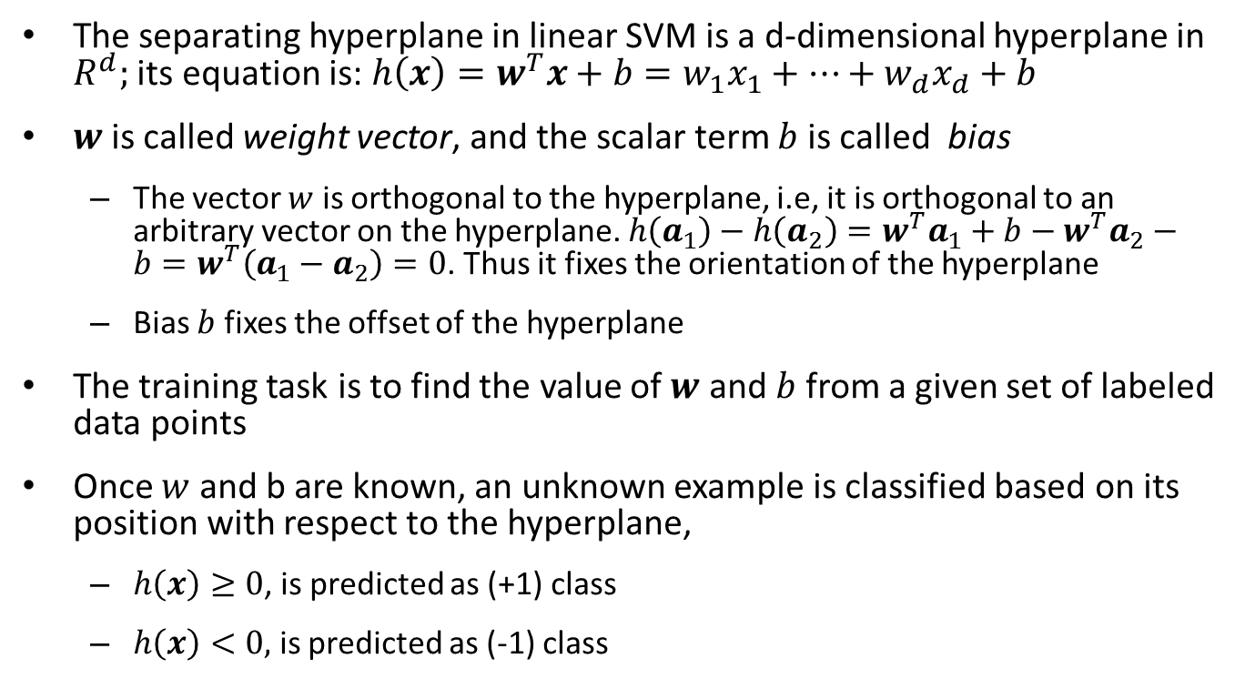
Linear SVM and hyperplane
The separating hyperplane in linear SVM is a d-dimensional hyperplane in $R^{d};$ its equation is: $h\left(x\right)=w^{T}x+b=w_{1}x_{1}+⋯+w_{d}x_{d}+b$
$w$is called weight vector, and the scalar term $b$ is called bias
The vector $w$ is orthogonal to the hyperplane, i.e, it is orthogonal to an arbitrary vector on the hyperplane. $h\left(a_{1}\right)−h\left(a_{2}\right)=w^{T}a_{1}+b−w^{T}a_{2}−b=w^{T}\left(a_{1}−a_{2}\right)=0$. Thus it fixes the orientation of the hyperplane
Bias $b$ fixes the offset of the hyperplane
The training task is to find the value of $w$ and $b$ from a given set of labeled data points
Once $w$ and b are known, an unknown example is classified based on its position with respect to the hyperplane,
$h\left(x\right)≥0$, is predicted as (+1) class
$h\left(x\right)<0,$ is predicted as (-1) class

Slide 4
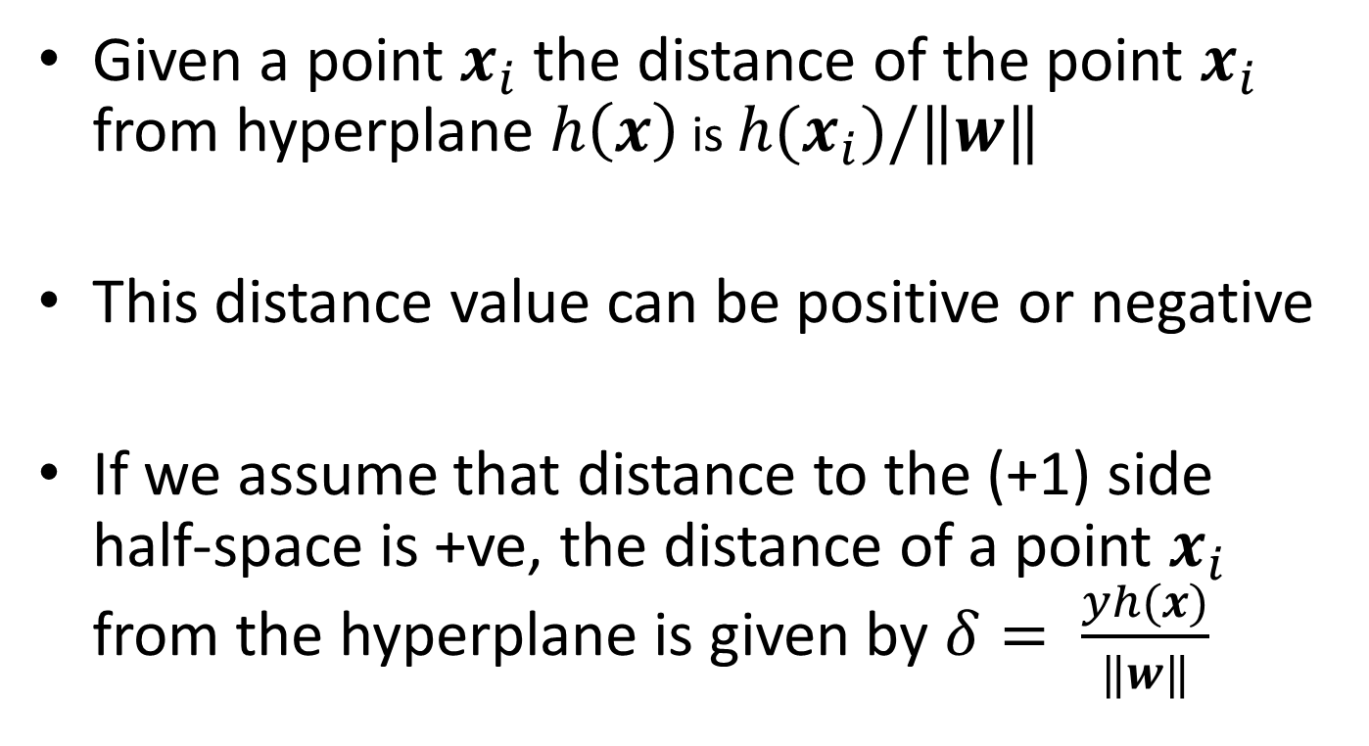
Distance to hyperplance
Given a point $x_{i}$ the distance of the point $x_{i}$ from hyperplane $h\left(x\right)$ is $h(x_{i})/‖w‖$
This distance value can be positive or negative
If we assume that distance to the (+1) side half-space is +ve, the distance of a point $x_{i}$ from the hyperplane is given by $δ= \frac{yh(x)}{‖w‖}$

Slide 5
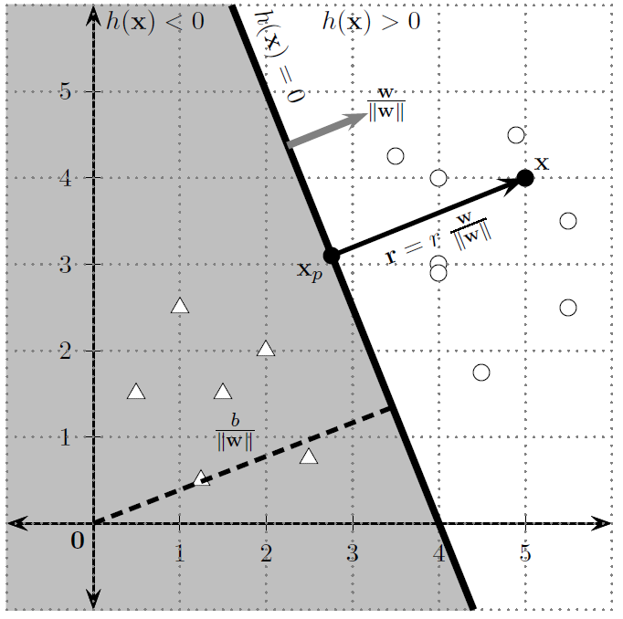
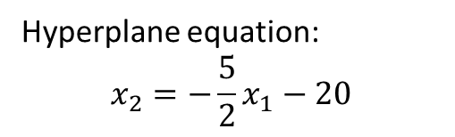
Example
Hyperplane equation:
$$x_{2}=−\frac{5}{2}x_{1}−20$$
Also note, the given data points are linearly separable, but for SVM it is not a requirement

Slide 6
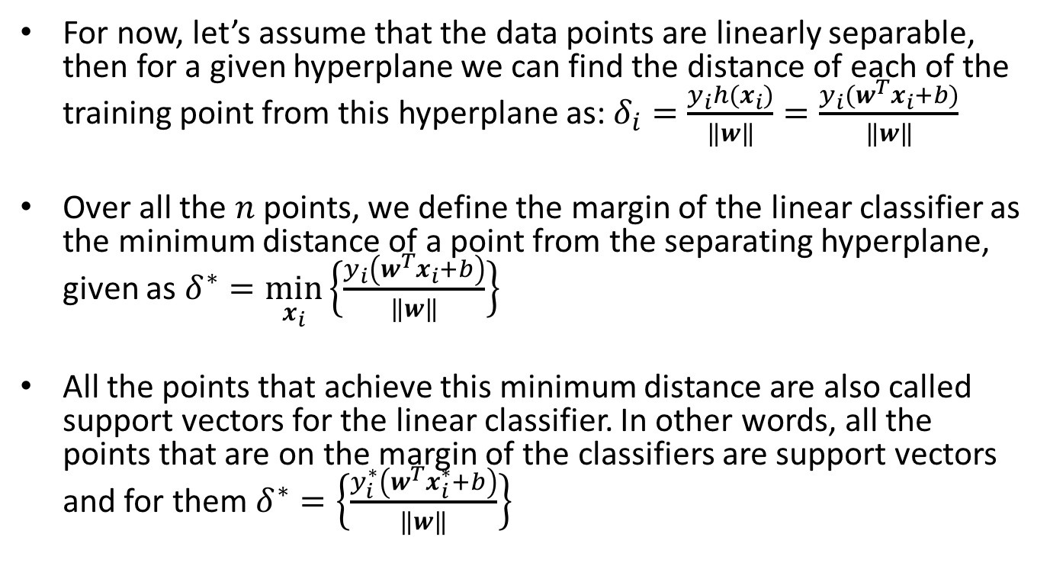
Margin and Support Vectors
For now, let’s assume that the data points are linearly separable, then for a given hyperplane we can find the distance of each of the training point from this hyperplane as: $δ_{i}=\frac{y_{i}h(x_{i})}{‖w‖}=\frac{y_{i}(w^{T}x_{i}+b)}{‖w‖}$
Over all the $n$ points, we define the margin of the linear classifier as the minimum distance of a point from the separating hyperplane, given as $δ^{∗}=\min_{x_{i}}\left\{\frac{y_{i}\left(w^{T}x_{i}+b\right)}{\left\|w\right\|}\right\}$
All the points that achieve this minimum distance are also called support vectors for the linear classifier. In other words, all the points that are on the margin of the classifiers are support vectors and for them $δ^{∗}=\left\{\frac{y_{i}^{∗}\left(w^{T}x_{i}^{∗}+b\right)}{\left\|w\right\|}\right\}$

Slide 7
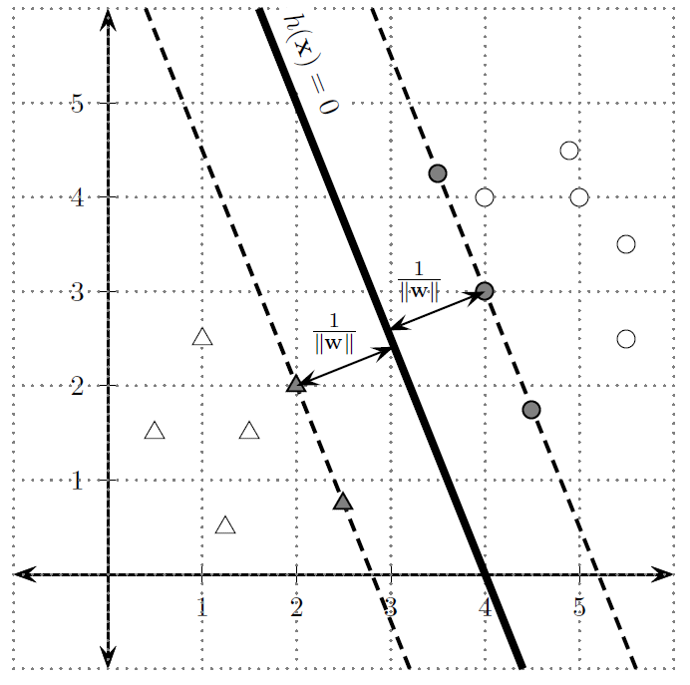
Example

Slide 8
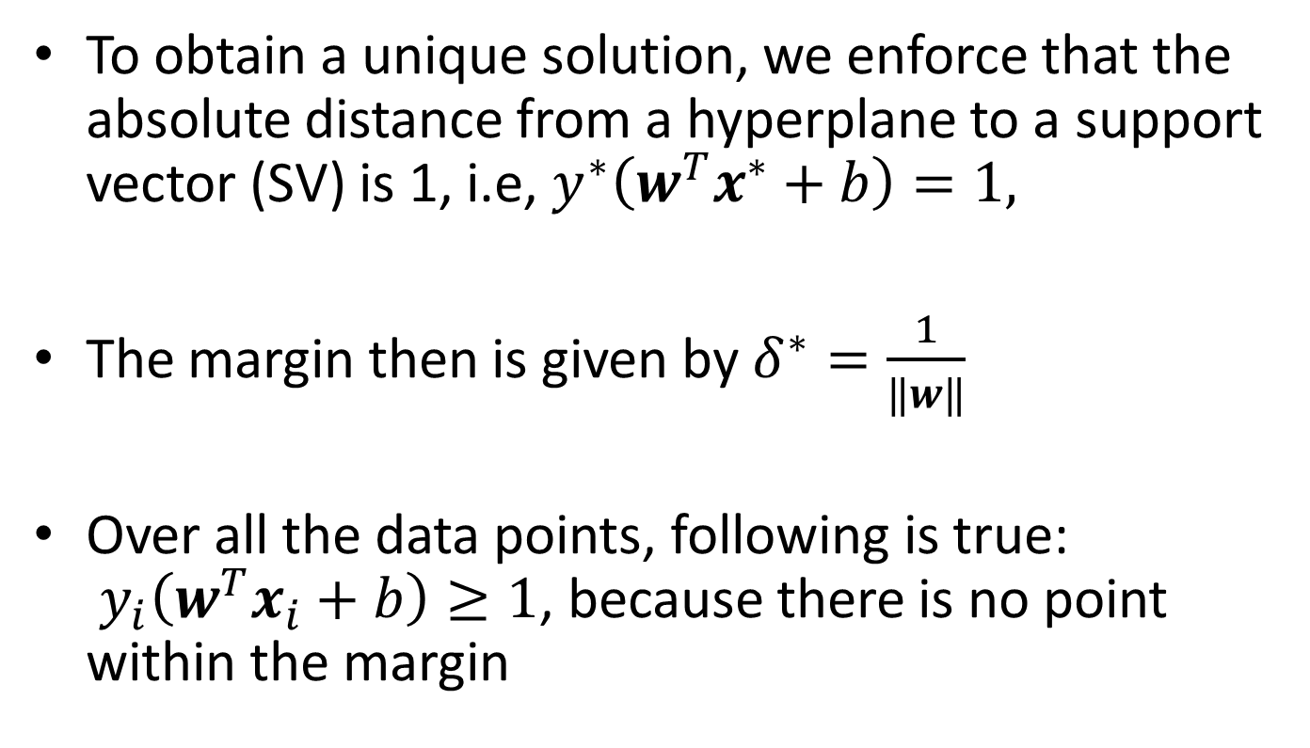
Canonical hyperplane
To obtain a unique solution, we enforce that the absolute distance from a hyperplane to a support vector (SV) is 1, i.e, $y^{∗}\left(w^{T}x^{∗}+b\right)=1,$
The margin then is given by $δ^{∗}=\frac{1}{‖w‖}$
Over all the data points, following is true: $y_{i}\left(w^{T}x_{i}+b\right)≥1$, because there is no point within the margin

Slide 9
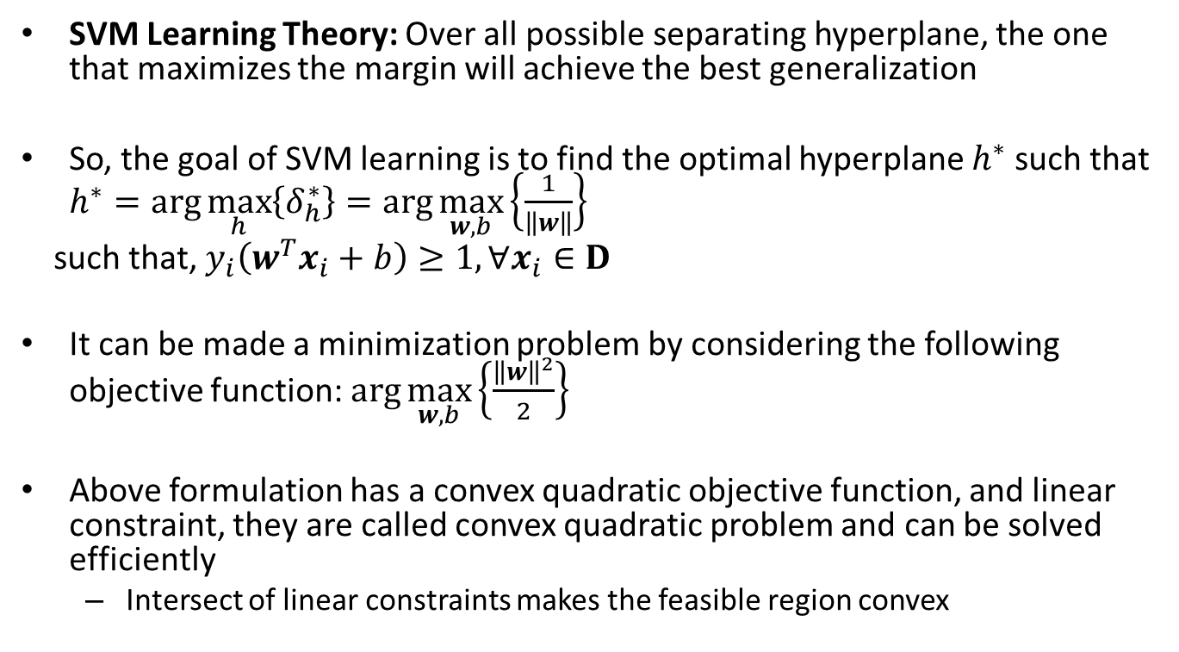
SVM Learning
SVM Learning Theory: Over all possible separating hyperplane, the one that maximizes the margin will achieve the best generalization
So, the goal of SVM learning is to find the optimal hyperplane $h^{∗}$ such that $h^{∗}=arg\max_{h}\left\{δ_{h}^{∗}\right\}=\arg{\max_{w, b}\left\{\frac{1}{\left\|w\right\|}\right\}}$
such that, $y_{i}\left(w^{T}x_{i}+b\right)≥1, ∀x_{i}∈D$
It can be made a minimization problem by considering the following objective function: $\arg{\max_{w, b}\left\{\frac{{\left\|w\right\|}^{2}}{2}\right\}}$
Above formulation has a convex quadratic objective function, and linear constraint, they are called convex quadratic problem and can be solved efficiently
Intersect of linear constraints makes the feasible region convex

Slide 10
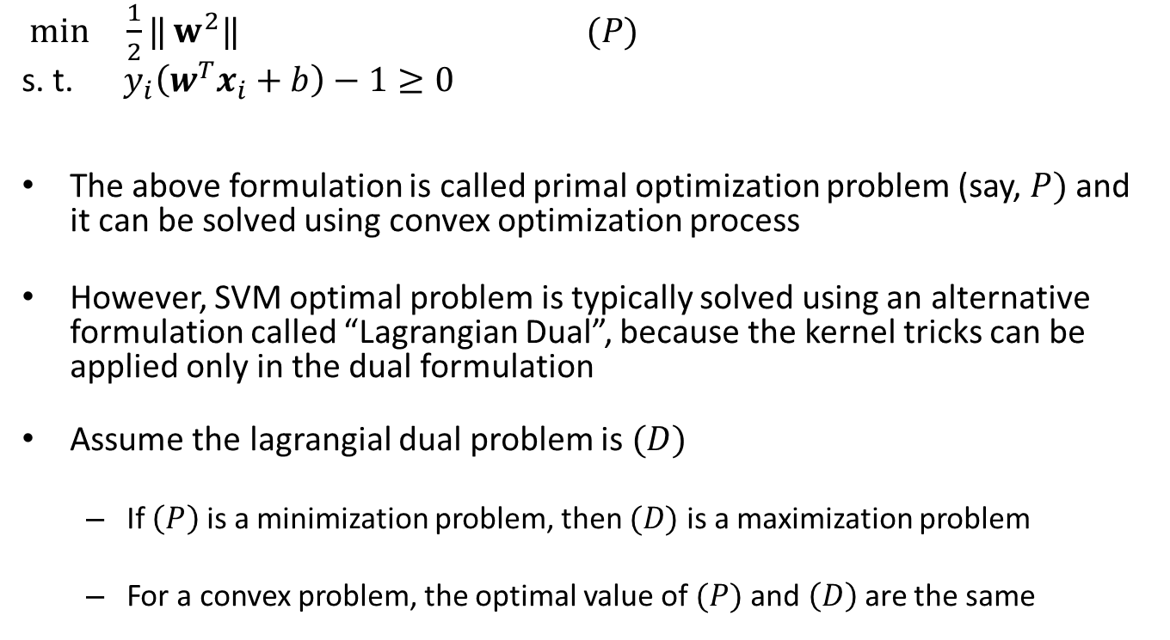
SVM Optimization formulation
$\min{ \frac{1}{2}‖}w^{2}‖$ $(P)$
s. t. $y_{i}\left(w^{T}x_{i}+b\right)−1≥0$
The above formulation is called primal optimization problem (say, $P)$and it can be solved using convex optimization process
However, SVM optimal problem is typically solved using an alternative formulation called “Lagrangian Dual”, because the kernel tricks can be applied only in the dual formulation
Assume the lagrangial dual problem is $(D)$
If $\left(P\right)$ is a minimization problem, then $(D)$ is a maximization problem
For a convex problem, the optimal value of $(P)$ and$\left(D\right)$ are the same

Slide 11
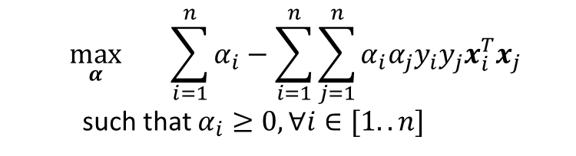
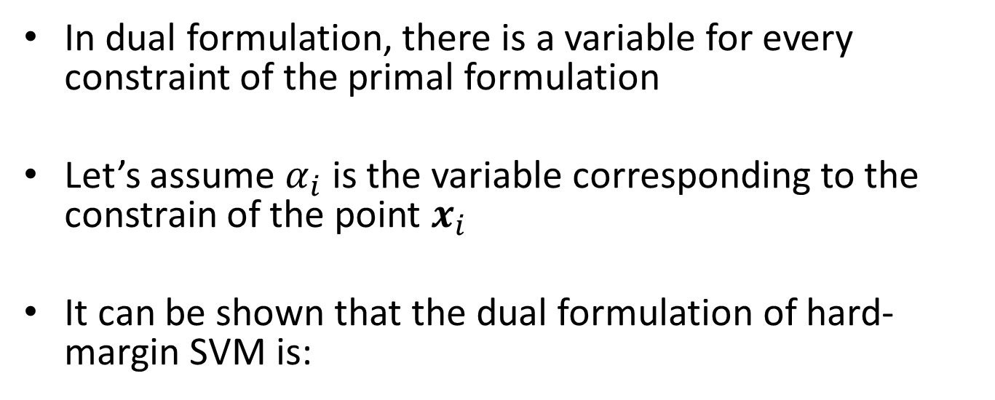
SVM Dual Formulation
In dual formulation, there is a variable for every constraint of the primal formulation
Let’s assume $α_{i}$ is the variable corresponding to the constrain of the point $x_{i}$
It can be shown that the dual formulation of hard-margin SVM is:
$$\max_{α}{\sum_{i=1}^{n}{α_{i}}−\sum_{i=1}^{n}{\sum_{j=1}^{n}{α_{i}α_{j}y_{i}y_{j}x_{i}^{T}x_{j}}} }$$
such that $α_{i}≥0, ∀i∈[1..n]$

Slide 12
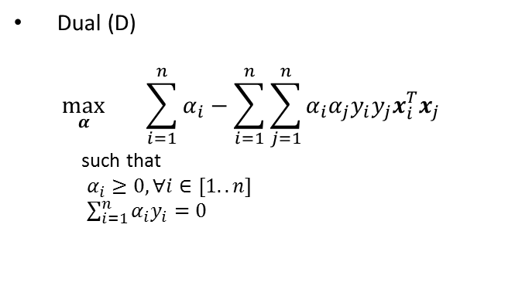

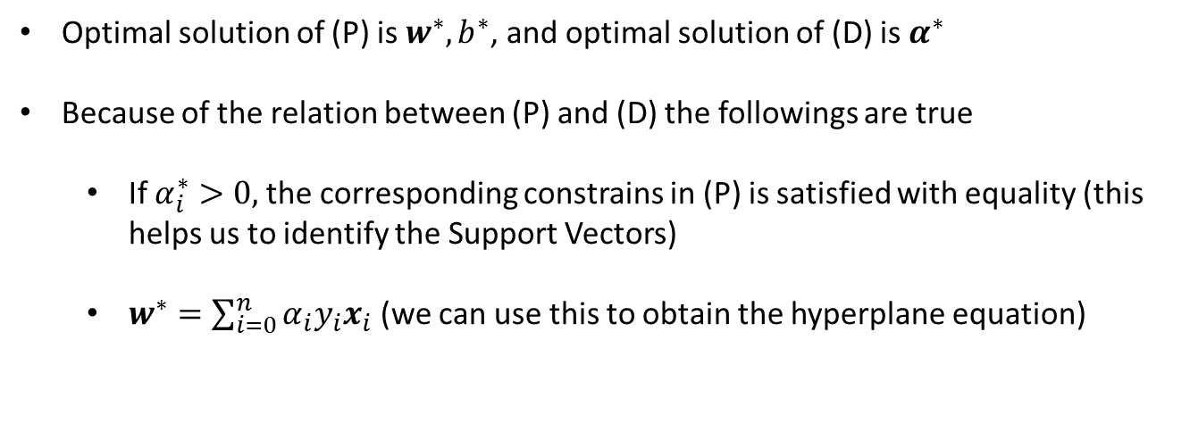
Primal and Dual
Primal (P)
$$\min_{b, w}{ \frac{1}{2}‖}w^{2}‖$$
s. t. $y_{i}\left(w^{T}x_{i}+b\right)−1≥0$
Dual (D)
$$\max_{α}{\sum_{i=1}^{n}{α_{i}}−\sum_{i=1}^{n}{\sum_{j=1}^{n}{α_{i}α_{j}y_{i}y_{j}x_{i}^{T}x_{j}}} }$$
such that
$α_{i}≥0, ∀i∈[1..n]$
$\sum_{i=1}^{n}{α_{i}y_{i}=0}$
Optimal solution of (P) is $w^{∗}, b^{∗}$, and optimal solution of (D) is $α^{∗}$
Because of the relation between (P) and (D) the followings are true
If $α_{i}^{∗}>0,$the corresponding constrains in (P) is satisfied with equality (this helps us to identify the Support Vectors)
$w^{∗}=\sum_{i=0}^{n}{α_{i}y_{i}x_{i}}$ (we can use this to obtain the hyperplane equation)

Slide 13
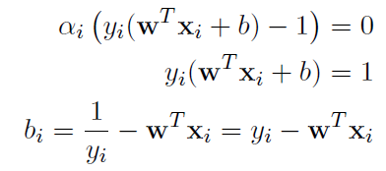

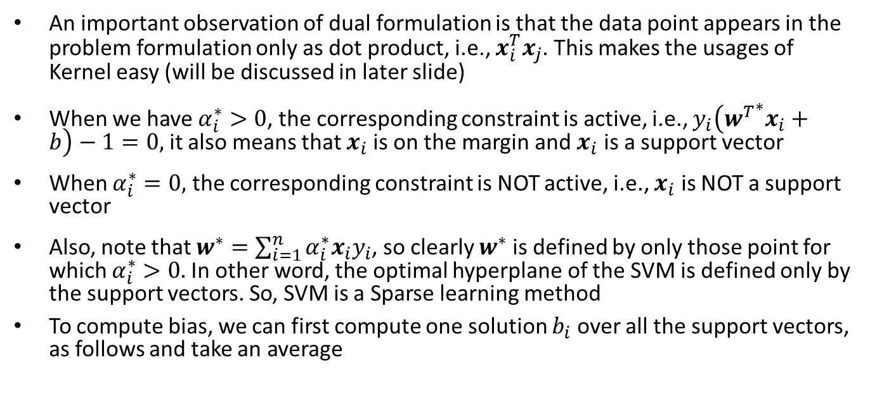
SVM learning (cont.)
An important observation of dual formulation is that the data point appears in the problem formulation only as dot product, i.e., $x_{i}^{T}x_{j}$. This makes the usages of Kernel easy (will be discussed in later slide)
When we have $α_{i}^{∗}>0$, the corresponding constraint is active, i.e., $y_{i}\left({w^{T}}^{∗}x_{i}+b\right)−1=0,$ it also means that $x_{i}$is on the margin and $x_{i}$ is a support vector
When $α_{i}^{∗}=0,$ the corresponding constraint is NOT active, i.e., $x_{i}$ is NOT a support vector
Also, note that $w^{∗}=\sum_{i=1}^{n}{α_{i}^{∗}x_{i}y_{i}}$, so clearly $w^{∗}$ is defined by only those point for which $α_{i}^{∗}>0.$In other word, the optimal hyperplane of the SVM is defined only by the support vectors. So, SVM is a Sparse learning method
To compute bias, we can first compute one solution $b_{i}$ over all the support vectors, as follows and take an average
Now, averaging over the support vectors

Slide 14
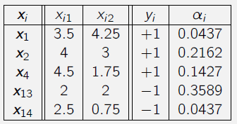
Example

Slide 15
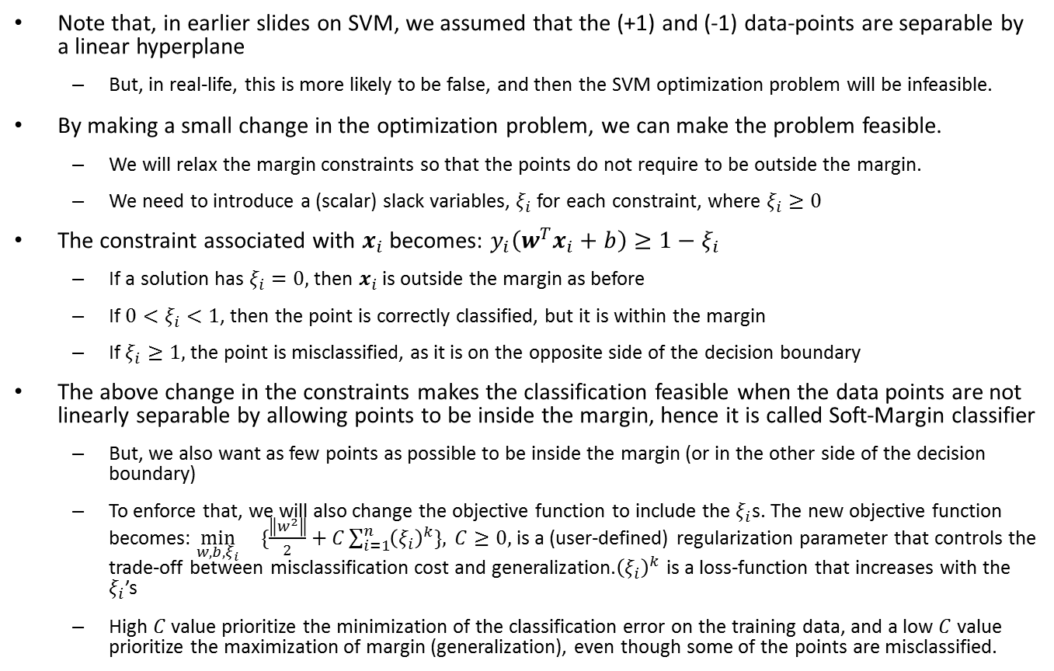
Soft Margin Classifier
Note that, in earlier slides on SVM, we assumed that the (+1) and (-1) data-points are separable by a linear hyperplane
But, in real-life, this is more likely to be false, and then the SVM optimization problem will be infeasible.
By making a small change in the optimization problem, we can make the problem feasible.
We will relax the margin constraints so that the points do not require to be outside the margin.
We need to introduce a (scalar) slack variables, $ξ_{i}$ for each constraint, where $ξ_{i}≥0$
The constraint associated with $x_{i}$ becomes: $y_{i}\left(w^{T}x_{i}+b\right)≥1−ξ_{i}$
If a solution has $ξ_{i}=0,$ then $x_{i}$ is outside the margin as before
If $0<ξ_{i}<1$, then the point is correctly classified, but it is within the margin
If $ξ_{i}≥1,$ the point is misclassified, as it is on the opposite side of the decision boundary
The above change in the constraints makes the classification feasible when the data points are not linearly separable by allowing points to be inside the margin, hence it is called Soft-Margin classifier
But, we also want as few points as possible to be inside the margin (or in the other side of the decision boundary)
To enforce that, we will also change the objective function to include the $ξ_{i}$s. The new objective function becomes: $\min_{w,b,ξ_{i}}{ \{\frac{\left\|w^{2}\right\|}{2}+C\sum_{i=1}^{n}{{\left(ξ_{i}\right)}^{k}\}, }}C≥0,$ is a (user-defined) regularization parameter that controls the trade-off between misclassification cost and generalization.${\left(ξ_{i}\right)}^{k}$ is a loss-function that increases with the $ξ_{i}$’s
High $C$ value prioritize the minimization of the classification error on the training data, and a low $C$ value prioritize the maximization of margin (generalization), even though some of the points are misclassified.

Slide 16
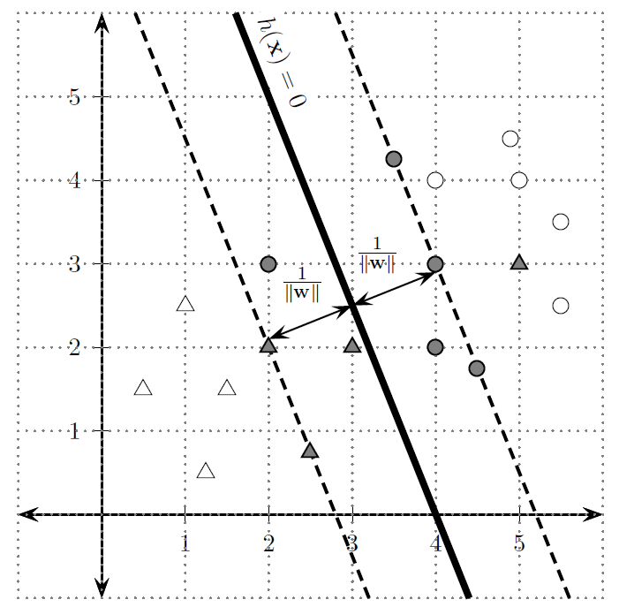
Soft margin

Slide 17
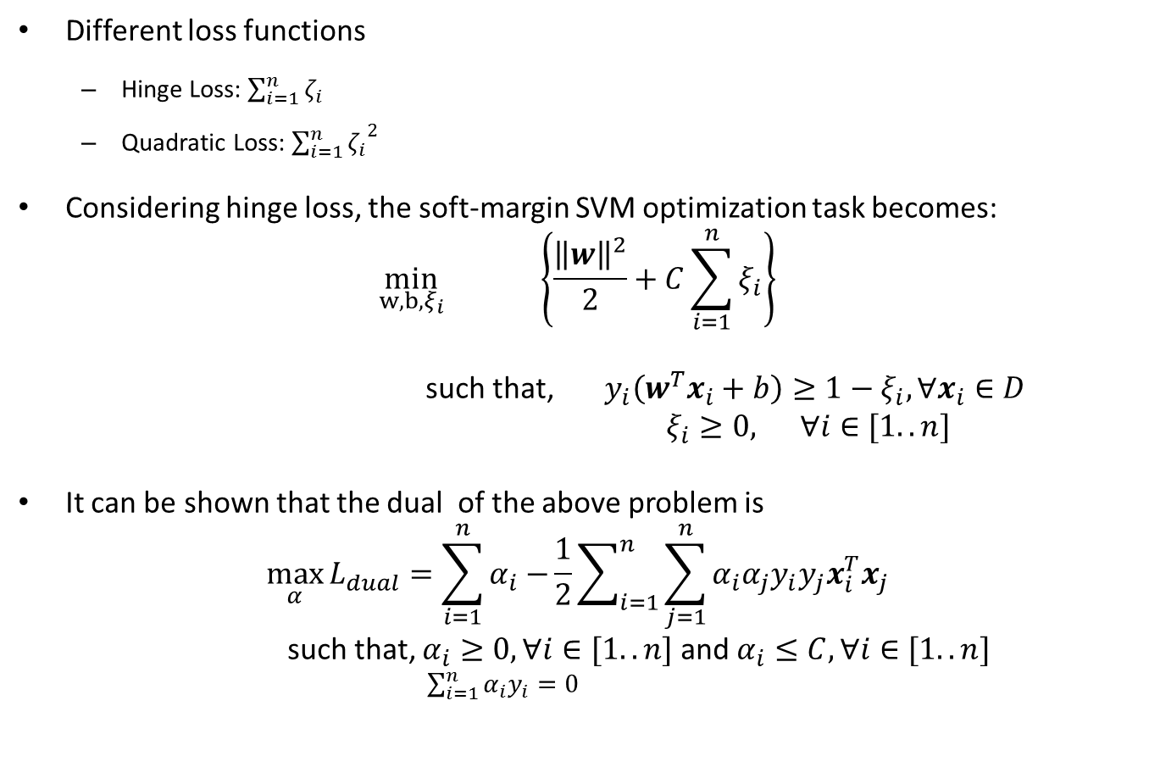
Loss function
Different loss functions
Hinge Loss: $\sum_{i=1}^{n}{ζ_{i}}$
Quadratic Loss: ${\sum_{i=1}^{n}{ζ_{i}}}^{2}$
Considering hinge loss, the soft-margin SVM optimization task becomes:
$$\min_{w,b,ξ_{i}}{ \left\{\frac{{\left\|w\right\|}^{2}}{2}+C\sum_{i=1}^{n}{ξ_{i}}\right\}}$$
such that, $y_{i}\left(w^{T}x_{i}+b\right)≥1−ξ_{i}, ∀x_{i}∈D$
$ξ_{i}≥0,$ $∀i∈[1..n]$
It can be shown that the dual of the above problem is
$$\max_{α}{L_{dual}=\sum_{i=1}^{n}{α_{i}−}\frac{1}{2}\sum_{i=1}^{n}{\sum_{j=1}^{n}{α_{i}α_{j}y_{i}y_{j}x_{i}^{T}x_{j}}}}$$
such that, $α_{i}≥0,∀i∈[1..n]$and $α_{i}≤C, ∀i∈[1..n]$
$\sum_{i=1}^{n}{α_{i}y_{i}=0}$

Slide 18
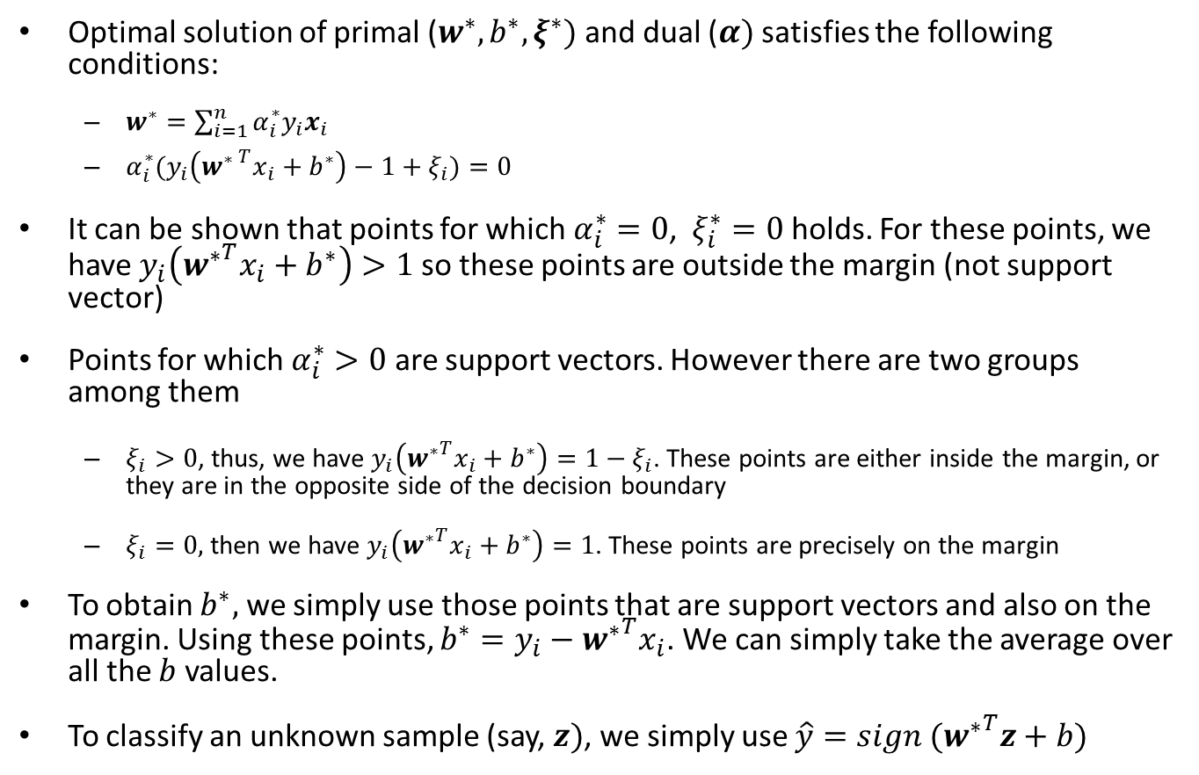
w*, b*, and the support vectors
Optimal solution of primal ($w^{∗}, b^{∗},ξ^{∗})$and dual ($α)$satisfies the following conditions:
$w^{∗}=\sum_{i=1}^{n}{α_{i}^{∗}y_{i}x_{i}}$
$α_{i}^{∗}{(y}_{i}\left({w^{∗ }}^{T}x_{i}+b^{∗}\right)−1+ξ_{i})=0$
It can be shown that points for which $α_{i}^{∗}=0$, $ξ_{i}^{∗}=0$ holds. For these points, we have $y_{i}\left({w^{∗}}^{T}x_{i}+b^{∗}\right)>1$ so these points are outside the margin (not support vector)
Points for which $α_{i}^{∗}>0$ are support vectors. However there are two groups among them
$ξ_{i}>0$, thus, we have $y_{i}\left({w^{∗}}^{T}x_{i}+b^{∗}\right)=1−ξ_{i}$. These points are either inside the margin, or they are in the opposite side of the decision boundary
$ξ_{i}=0,$ then we have $y_{i}\left({w^{∗}}^{T}x_{i}+b^{∗}\right)=1$. These points are precisely on the margin
To obtain $b^{∗},$ we simply use those points that are support vectors and also on the margin. Using these points, $b^{∗}=y_{i}−{w^{∗}}^{T}x_{i}$. We can simply take the average over all the $b$ values.
To classify an unknown sample (say, $z)$, we simply use $\hat{y}=sign ({w^{∗}}^{T}z+b)$

Slide 19
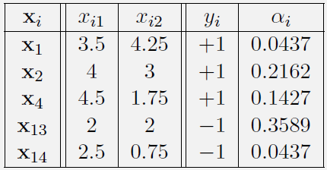
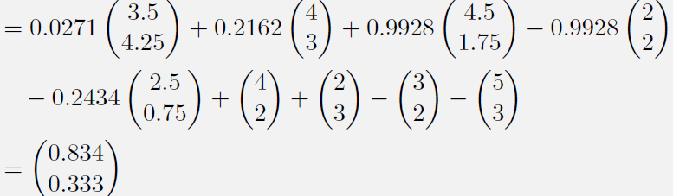

Example
Support Vectors on the margin
Support Vector not on the Margin
$$w=$$

Slide 20
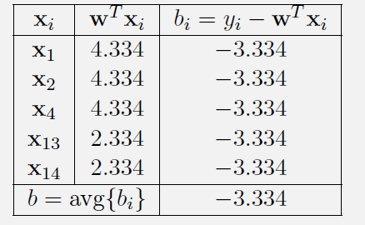

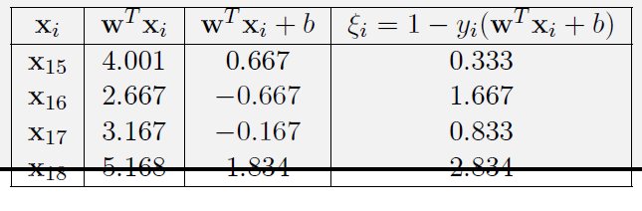

Example (cont.)
$$b$$
The optimal hyperplane is given by:
$$ξ_{i}$$

Slide 21
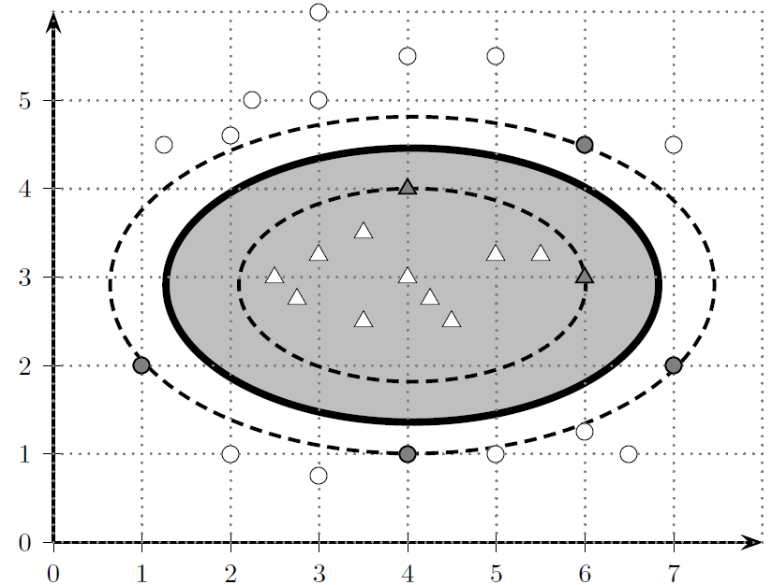
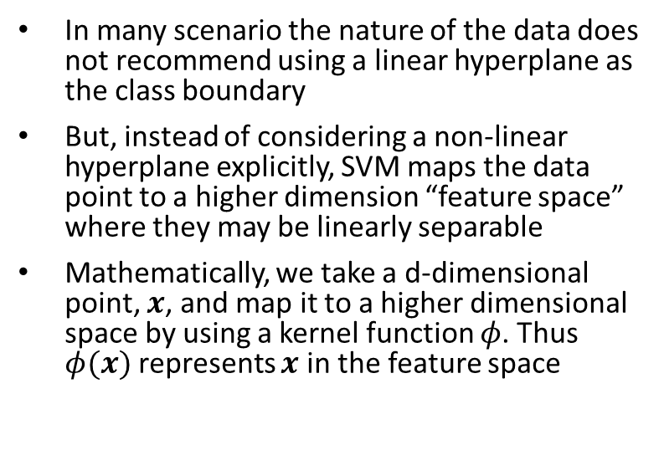
Kernel SVM (non-Linear SVM)
In many scenario the nature of the data does not recommend using a linear hyperplane as the class boundary
But, instead of considering a non-linear hyperplane explicitly, SVM maps the data point to a higher dimension “feature space” where they may be linearly separable
Mathematically, we take a d-dimensional point, $x$, and map it to a higher dimensional space by using a kernel function $φ$. Thus $φ(x)$ represents $x$ in the feature space
However, explicit mapping may be costly (as feature space dimensional may be infinite, or we may not have a analytic formation of the function $φ$)
The “kernel trick” is that we never compute $φ(x)$ in isolation, rather in the feature space, only operation we are allowed to do is the dot product, i.e., $φ{\left(x_{i}\right)}^{T}φ(x_{j})$
Strictly speaking, kernel trick is a way of mapping data points to an inner product space (also called Hilbert space), without ever having to compute the mapping explicitly.

Slide 22
Kernel function
A function $K(x_{i}, x_{j})$ is a kernel function iff there is a feature map $φ$ such that for all $x_{i}, x_{j}$ we have $K\left(x_{i}, x_{j}\right)=φ{\left(x_{i}\right)}^{T}φ(x_{j})$
Any learning algorithm that only depends on the inner product of instances can be called a kernel method
Assume that the dataset has $n$ instances. The Kernel (Gram) matrix $K$ is an $n×n$ matrix including the inner products between all pair of examples. $K\left(i, j\right)=φ{\left(x_{i}\right)}^{T}φ(x_{j})$. Clearly, $K$ is symmetric.
Mercer’s theorem: A symmetric function $K(:,:)$ is a kernel if and only if for any finite sample $S$, the kernel matrix for $S$ is positive semi-definite
In simpler terms, Mercer’s theorem guaranty that if we can design a similarity function such that for any set of instances, the gram matrix is positive semidefinite, then there exist a Hilbert space $F$, and a mapping $φ:X→F,$ such that $K\left(x_{i}, x_{j}\right)=φ{\left(x_{i}\right)}^{T}φ(x_{j})$

Slide 23
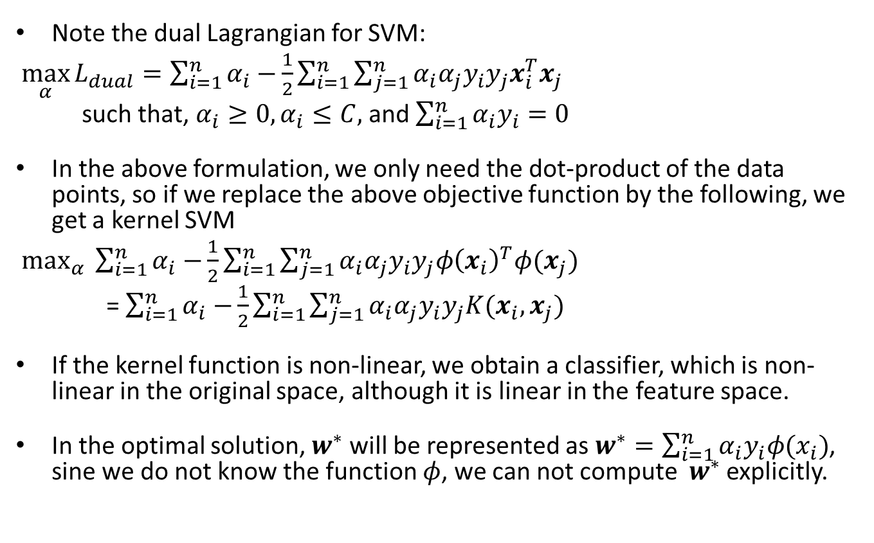
Kernel SVM
Note the dual Lagrangian for SVM:
$\max_{α}{L_{dual}=\sum_{i=1}^{n}{α_{i}−}\frac{1}{2}\sum_{i=1}^{n}{\sum_{j=1}^{n}{α_{i}α_{j}y_{i}y_{j}x_{i}^{T}x_{j}}}}$
such that, $α_{i}≥0, α_{i}≤C,$ and $\sum_{i=1}^{n}{α_{i}y_{i}=0}$
In the above formulation, we only need the dot-product of the data points, so if we replace the above objective function by the following, we get a kernel SVM
$\max_{α}{\sum_{i=1}^{n}{α_{i}−}\frac{1}{2}\sum_{i=1}^{n}{\sum_{j=1}^{n}{α_{i}α_{j}y_{i}y_{j}φ{\left(x_{i}\right)}^{T}φ(x_{j})}}}$
= $\sum_{i=1}^{n}{α_{i}−}\frac{1}{2}\sum_{i=1}^{n}{\sum_{j=1}^{n}{α_{i}α_{j}y_{i}y_{j}K(x_{i}, x_{j})}}$
If the kernel function is non-linear, we obtain a classifier, which is non-linear in the original space, although it is linear in the feature space.
In the optimal solution, $w^{∗}$ will be represented as $w^{∗}=\sum_{i=1}^{n}{α_{i}y_{i}φ(x_{i})}$, sine we do not know the function $φ$, we can not compute $w^{∗}$ explicitly.

Slide 24
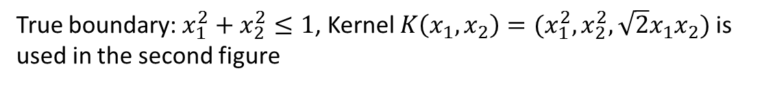
Using Kernel for solving non-linear cases
True boundary: $x_{1}^{2}+x_{2}^{2}≤1$, Kernel $K\left(x_{1},x_{2}\right)=(x_{1}^{2}, x_{2}^{2}, \sqrt{2}x_{1}x_{2})$ is used in the second figure

Slide 25
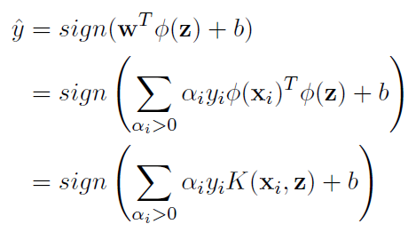
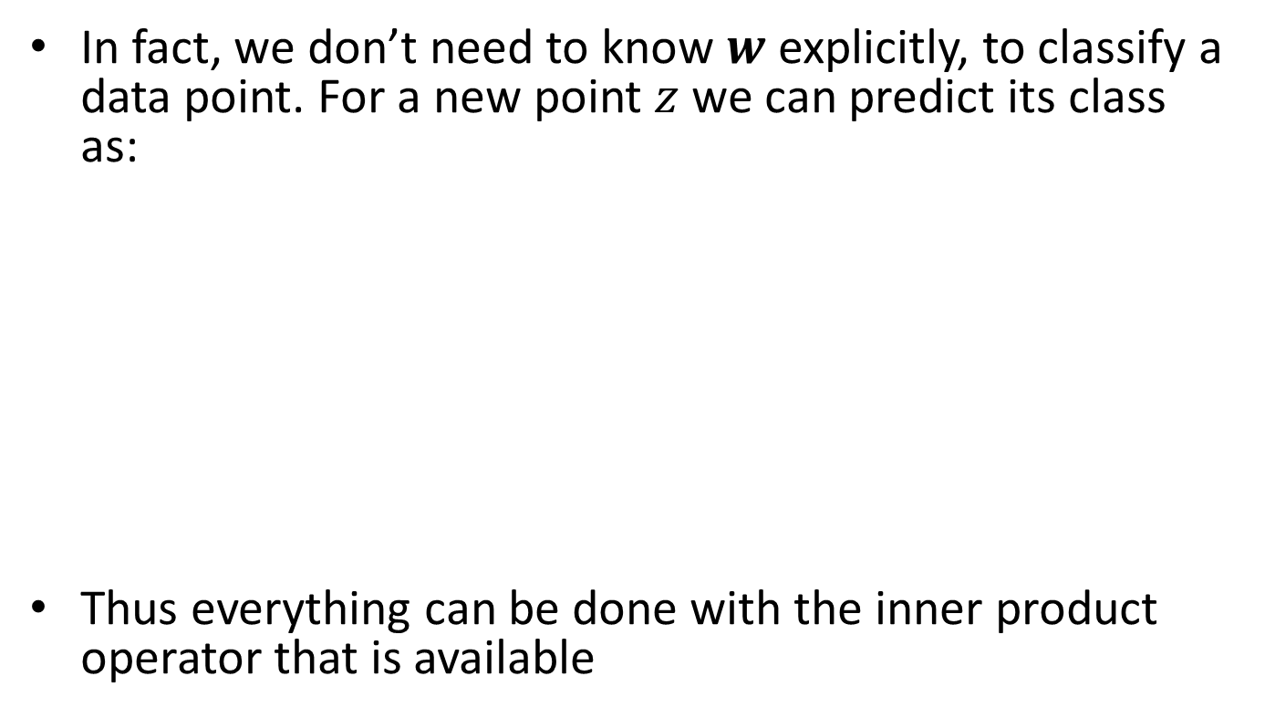
Kernel SVM classification
In fact, we don’t need to know $w$explicitly, to classify a data point. For a new point $z$ we can predict its class as:
Thus everything can be done with the inner product operator that is available

